Slide 1
📌 Lesson Plan 01: Introduction to AI Lab
Course: CSC4226 – Artificial Intelligence & Expert Systems
Lab Session: 1
Duration: 1.5 – 2 hours
Objective:
Understand the basics of AI and its applications.
Set up Python and essential AI libraries.
Write the first AI-based program.
Lab 1: Introduction to AI Programming
Overview of AI tools and libraries (Python, Prolog, LISP)
Introduction to Python for AI (NumPy, Pandas, Matplotlib)
Setting up Jupyter Notebook / Google Colab
📝 Part 1: Introduction to AI (20-30 mins)
Discussion Topics:
1. What is AI?
a. Definition and importance of Artificial Intelligence.
-> AI is the ability of machines to mimic human intelligence, solve problems, and perform tasks autonomously.
Python works on different platforms (Windows, Mac, Linux, Raspberry Pi, etc).
Python has a simple syntax similar to the English language.
Python has syntax that allows developers to write programs with fewer lines than some other programming languages.
Python runs on an interpreter system, meaning that code can be executed as soon as it is written. This means that prototyping can be very quick.
Python can be treated in a procedural way, an object-oriented way or a functional way.
b. AI vs. Machine Learning vs. Expert Systems.
2. Applications of AI:
a. Virtual Assistants (Siri, Alexa)

Slide 2
Self-driving Cars
Chatbots
Medical Diagnosis Systems
Key Aspects of AI:
⬛ Machine Learning (ML): AI systems learn from data and improve their performance without explicit programming.
⬛ Natural Language Processing (NLP): AI understands, interprets, and generates human language (e.g., chatbots, voice assistants).
⬛ Computer Vision: AI processes and analyzes visual data from images or videos.
⬛ Expert Systems: AI-based systems that provide decision-making support in fields like healthcare and finance.
⬛ Robotics: AI-powered robots that interact with the physical world
Types of AI:
Weak AI (NLP, chatbots)
Strong AI (Autonomous decision-making)
Tools or IDEs
Jupyter Notebook
Google Colab
Anaconda (Spyder, Jupyter)
PyCharm
VS Code
RStudio
MATLAB C Simulink
SWI-Prolog
LispWorks
Eclipse + PyDev
IntelliJ IDEA
🖥️ Part 2: Setting Up the AI Programming Environment (30-40 mins)
Step 1: Install Python s Jupyter Notebook/ VScode/ Google colab
Introduction to Jupyter Notebook/VScode and how to use it.

Slide 3
How to Install Jupyter Notebook 🖥️📓
Jupyter Notebook is a powerful tool for Python programming, AI, Data Science, and Machine
Learning. Follow these steps to install it on your system.
🔹 Method 1: Install Using Anaconda (Recommended for Beginners)
Anaconda is a complete package that includes Jupyter Notebook, Python, and commonly used
libraries.
📌 Step 1: Download Anaconda
³ Download Anaconda
Choose the latest version for Windows, macOS, or Linux.
Install it with the default settings.
📌 Step 2: Launch Jupyter Notebook
After installation, open Anaconda Navigator and click on Jupyter Notebook, or use the command:
jupyter notebook
🔹 Method 2: Install Using pip (For Python Users)
If you already have Python installed, you can install Jupyter Notebook using pip.
📌 Step 1: Install Python
Ensure Python 3.x is installed: python --version
If Python is not installed, download it from:
³ Download Python
📌 Step 2: Install Jupyter Notebook
Run the following command in Command Prompt (Windows) or Terminal (Mac/Linux):
pip install notebook

Slide 4
📌 Step 3: Launch Jupyter Notebook
Once installed, start Jupyter Notebook by running:
jupyter notebook
This will open Jupyter Notebook in your web browser.
🔹 Method 3: Install in a Virtual Environment (Advanced Users)
If you want to install Jupyter Notebook in a virtual environment, follow these steps:
📌 Step 1: Create a Virtual Environment
python -m venv myenv
Activate it:
Windows: myenv\Scripts\activate
Mac/Linux: source myenv/bin/activate
📌 Step 2: Install Jupyter Notebook
pip install notebook
📌 Step 3: Run Jupyter Notebook
jupyter notebook
🎯 Verify Installation
To check if Jupyter Notebook is installed correctly, run:
jupyter --version
**Visual Studio Code (VS Code)

Slide 5
🔹 Step 1: Install VS Code
🔗 Download VS Code
🔹 Step 2: Install Python
🔗 Download Python
✔️ Make sure to check the box "Add Python to PATH" during installation. After installation, verify it by running:
python --version
🔹 Step 3: Install Python Extension in VS Code
1️⃣ Open VS Code
2️⃣ Go to Extensions (Ctrl + Shift + X or Cmd + Shift + X on Mac)
3️⃣ Search for Python
4️⃣ Click Install
🔹 Step 4: Create a Python File
1️⃣ Open VS Code
2️⃣ Click File → New File
3️⃣ Save the file as my_program.py
🔹 Step 5: Write Python Code
Example:

Slide 6
print("Hello, World!")
🔹 Step 6: Run the Code
✅ Method 1: Using the Run Button
1️⃣ Click the ▶ Run button at the top-right corner.
2️⃣ The output appears in the Terminal.
✅ Method 2: Using Terminal (Recommended)
1️⃣ Open Terminal (Ctrl + ~)
2️⃣ Navigate to the file location using cd (if needed)
3️⃣ Run the command:
python my_program.py
# Windows/Mac/Linux
or (if using Python 3):
python3 my_program.py
Step 2: Install Essential Libraries
Install AI-related libraries using the following commands in Jupyter Notebook:
pip install numpy pandas matplotlib scikit-learn
(Optional: Install TensorFlow for future labs)
pip install tensorflow keras

Slide 7
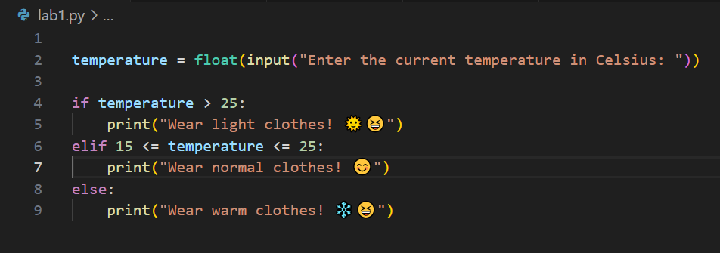

💻 Part 3: Writing the First AI-Based Program (30 mins)
Activity: Implementing a Simple AI-based Decision System
write a Python program that makes a decision using an IF-ELSE rule-based system.
z‘v’ Task 1: AI-based Weather Recommendation System
If the temperature is above 25°C, suggest “Wear light clothes”.
If the temperature is between 15°C and 25°C, suggest “Wear normal clothes”.
If the temperature is below 15°C, suggest “Wear warm clothes”.
⬛ Python Code:
emoji · PyPI
🎁 Emoji cheat sheet for GitHub, Basecamp, Slack & more
** Indentation(Spaces)
** Variables (need not any command)
** Comments(#) or CTRL+/
**pip install emoji
’z‘v Task 2: A bank needs an AI system to decide whether a customer is eligible for a loan
based on their salary and credit score.
Rules:
⬛ If salary is above $50,000 and credit score is above 700, suggest “Loan Approved”.
⬛ If salary is between $30,000 and $50,000 and credit score is above 650, suggest

Slide 8
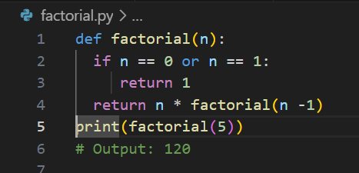
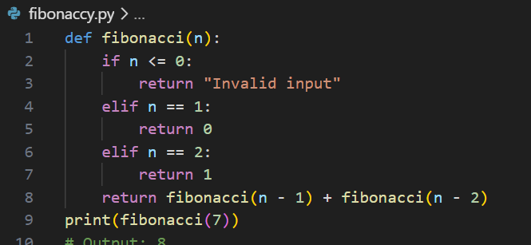
“Loan Approved with Conditions”.
⬛ If salary is below $30,000 or credit score is below 650, suggest “Loan Denied”.
Task 3 : Recursion Problems
1️⃣ Factorial Calculation (Basic)
Write a recursive function to compute the factorial of a number.
Example:
2️⃣ Fibonacci Series (Intermediate)
Write a recursive function to find the nth Fibonacci number.
Example:

Slide 9
3️⃣ Sum of Digits (Intermediate)
Write a recursive function to find the sum of digits of a number.
Example:
def sum_of_digits(n): if n == 0:
return 0
return (n % 10) + sum_of_digits(n // 10)
print(sum_of_digits(1234)) # Output: 10
4️⃣ Tower of Hanoi (Advanced)
Solve the Tower of Hanoi problem using recursion.
Example:
def tower_of_hanoi(n, source, auxiliary, destination): if n == 1:
print(f"Move disk 1 from {source} to {destination}") return
tower_of_hanoi(n - 1, source, destination, auxiliary)
print(f"Move disk {n} from {source} to {destination}") tower_of_hanoi(n - 1, auxiliary, source, destination)
tower_of_hanoi(3, 'A', 'B', 'C')
Task 4 Graph Problems
5️⃣ Depth-First Search (DFS)
Write a recursive function to perform DFS traversal on a graph.
Example:

Slide 10
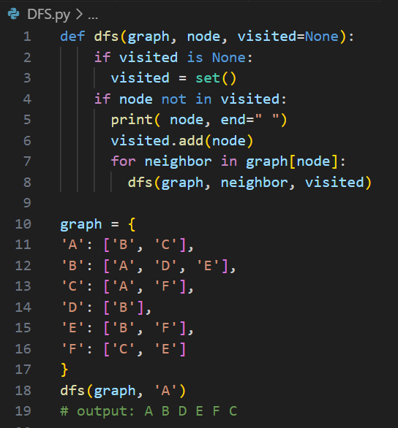
6️⃣ Breadth-First Search (BFS) Implement BFS traversal using a queue. Example:
from collections import deque
def bfs(graph, start): visited = set()
queue = deque([start])
while queue:
node = queue.popleft() if node not in visited:
print(node, end=" ") visited.add(node) queue.extend(graph[node])

Slide 11
graph = {
'A': ['B', 'C'],
'B': ['A', 'D', 'E'],
'C': ['A', 'F'],
'D': ['B'],
'E': ['B', 'F'],
'F': ['C', 'E']
}
bfs(graph, 'A')
# Output: A B C D E F
7️⃣ Detect Cycle in an Undirected Graph
Use DFS to check if a graph contains a cycle.
Example:
def is_cyclic(graph, node, visited, parent): visited.add(node)
for neighbor in graph[node]:
if neighbor not in visited:
if is_cyclic(graph, neighbor, visited, node): return True
elif parent != neighbor: return True
return False
def has_cycle(graph): visited = set() for node in graph:
if node not in visited:
if is_cyclic(graph, node, visited, None): return True
return False
graph = {
'A': ['B', 'C'],
'B': ['A', 'D'],

Slide 12
'C': ['A', 'D'],
'D': ['B', 'C']
}
print(has_cycle(graph))
# Output: True
z‘’v Next Lab Preview:
Implementing Search Algorithms (BFS s DFS) in Python.

